Slide 1
Kinetics It is the science that specializes in studying the rate (speed ) of chemical reactions and the factors affecting them.
Chemical reactions differ from one another in the amount of time required to occur. Some reactions occur immediately and do not require a long time to occur

Slide 2
In scientific terms, the speed at which a chemical reaction occurs is called the rate of reaction, and can be expressed as a specific change over a certain period of time measured in seconds, minutes, hours, days, or years.
The rate of a chemical reaction is usually expressed in terms of the change in the concentration or pressure of one of the components of the reaction. The rate can be defined as the rate of decrease in the concentration of one of the reactants or the rate of increase in the concentration of one of the products of the reaction.

Slide 3
Reaction rate or chemical reaction rate
It is the rate of change in the quantities (concentration) of reactants or products per unit of time. Or the rate of change in the reaction products per unit of time, i.e. it is the increase in the concentration of the products over time and the formation of the product.

Slide 4
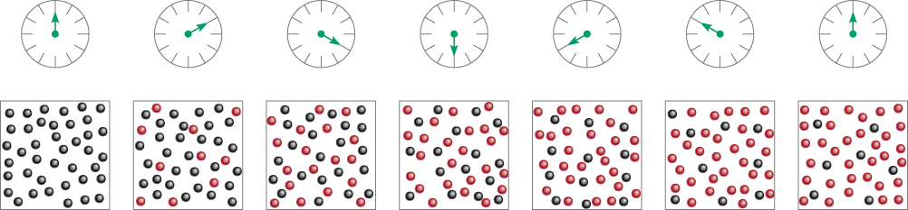
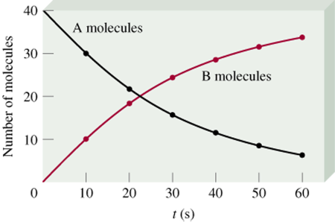


Practically, the reaction rate can be measured by measuring the rate of disappearance of a reactant or the rate of formation of a product. This is usually done by monitoring the change in one of the physical properties of the substance.
Time

Slide 5
Any chemical or physical phenomenon needs some time to occur. This time may be very short or very long
. If barium chloride is added to a sodium sulfate solution, a white precipitate is observed in the test tube
Ba Cl₂ + Na₂ SO₄ = Ba SO₄ + 2Na Cl
Also, the neutralization reactions between acid and alkaline solutions occur in a time that cannot be measured due to its shortness
OH⁻ + H⁺ = H₂O
While the reaction of oxygen gas with hydrogen gas to form water does not occur under normal conditions even if they remain in the same container for several days. O₂ + 2 H₂ = 2H₂O

Slide 6
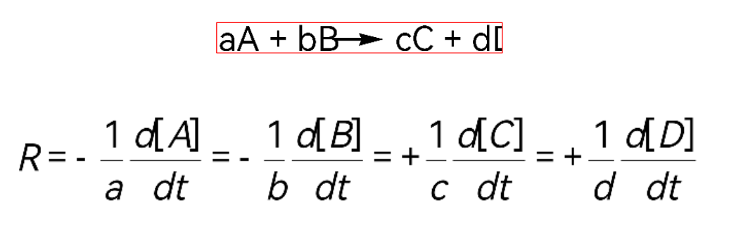
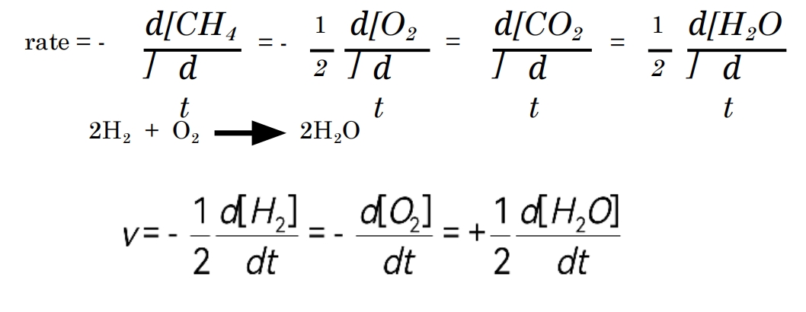
Rate of reaction (rate r)
CH₄ (g) + 2O₂ (g) CO₂ (g) + 2H₂O (g)

Slide 7
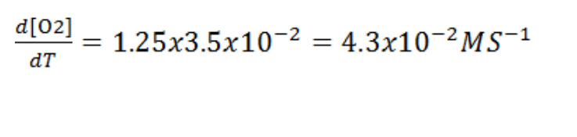
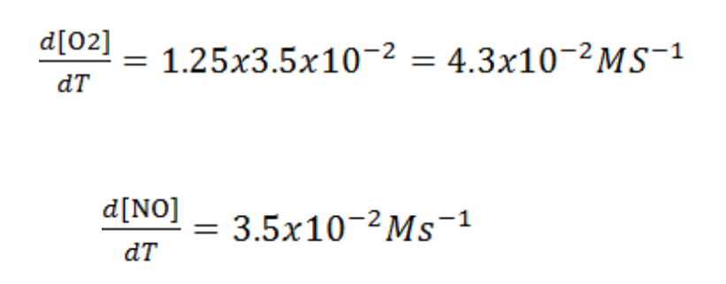
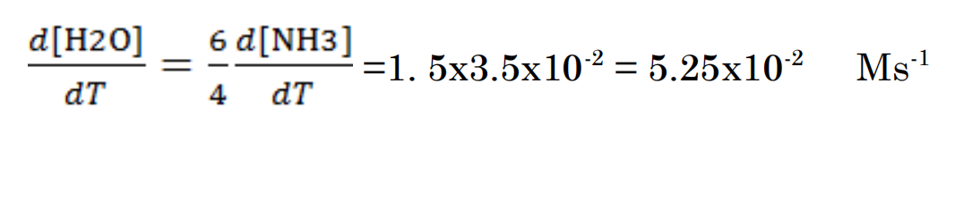

Slide 8
Factors affecting the rate of reactions
1- Nature of the reactants
2-Concentration
3-Temperature
4-Presence of catalyst

Slide 9
1-The nature of the reactants
The speed of the chemical reaction varies depending on the reactants and the medium in which the reaction takes place. In practice, it was found that the nature of the reactants has a clear effect on the speed of the reaction. This may be evident from the following example
MnO₄ reduction of permanganate ions by ions -
Ferrous in an acidic medium
Fe +2 Fe⁺³ + Mn+² ⁺ MnO₄⁻
It occurs quickly and this is noted by the disappearance of the color of permanganate, which indicates that the reaction is fast, while the reduction of the same ions by oxalic acid in an acidic medium occurs slowly, which indicates that the reaction is slow.
2H₂C₂O₄ + 6H+ 2 H₂O + 4CO₂ + 2Mn ⁺² + 2MnO₄⁻

Slide 10
2-Concentration of the reactants
It was noted that when:
the concentration of the reactants is high at the beginning of the reaction, the reaction speed is high and over time the concentration of the reactants decreases and the reaction speed decreases with it.
The relationship between the concentration of the reactants and the reaction speed It is not an easy relationship, as increasing the concentration of one of the reactants leads to an increase in the reaction rate. It may lead to a decrease, as in reverse reactions, and there may be no change in the rate
The temperature has a significant effect on the reaction rate, and it has been found practically that raising the temperature leads to a noticeable increase in the reaction rate

Slide 11
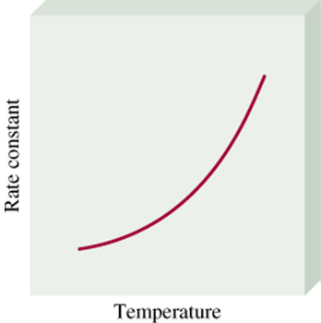
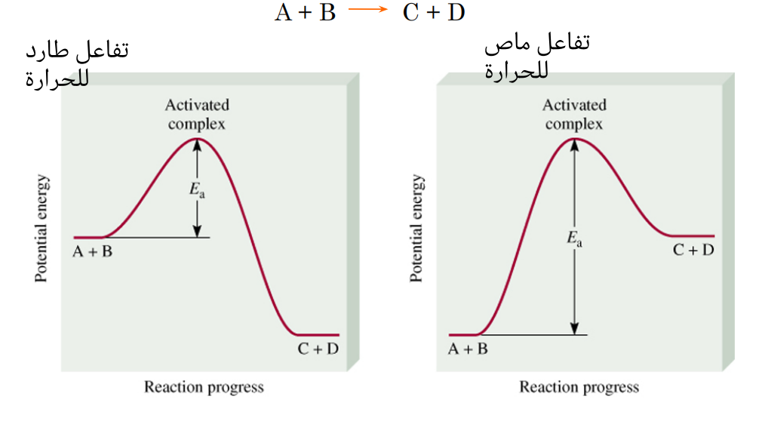
k = A • exp( -Ea/RT)
k = A • exp^{( -Ea/RT)}
R = 8.314 J.K.mol ( the general constant for gases)
Ea = activation energy and its units (J/mol)
A = frequency factor
T= absolute temperature

Slide 12
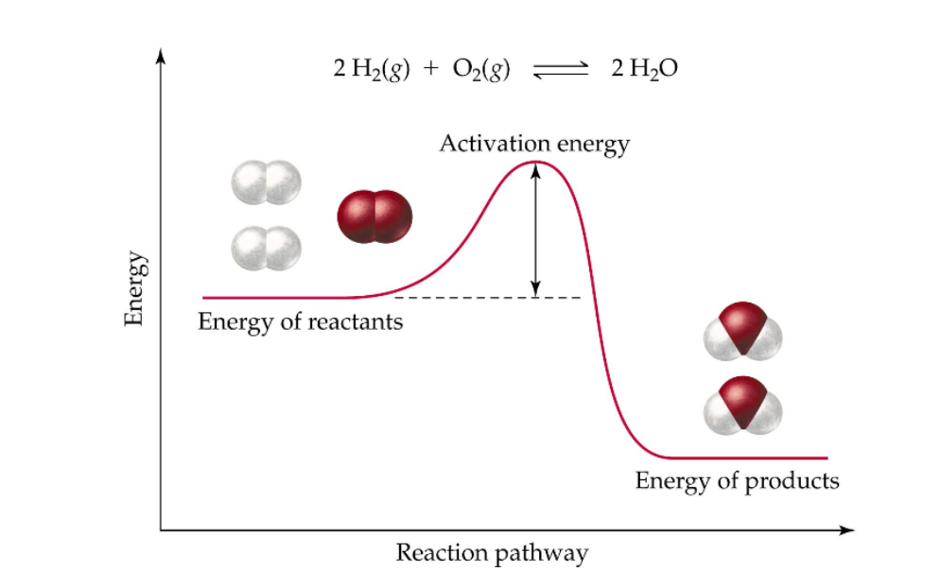
The activation energy: It is the minimum amount of energy required by the reacting molecules to reach the active state, for the reaction to occur, and for them to be able to form products.

Slide 13
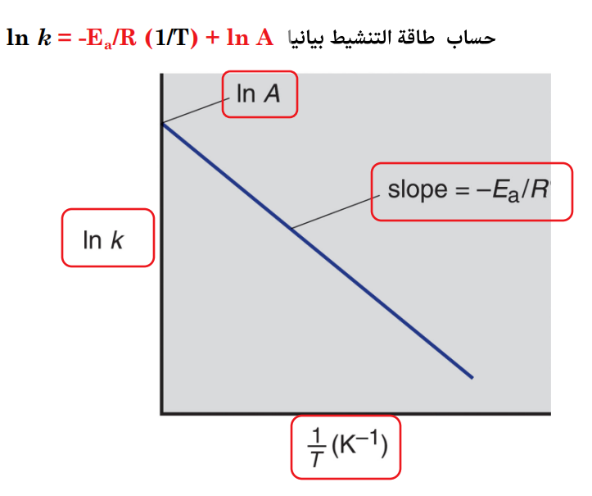
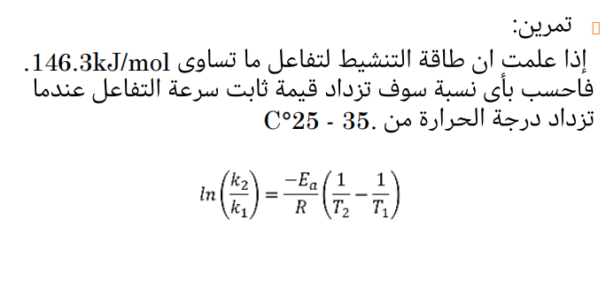
Arrhenius equation:

Slide 14
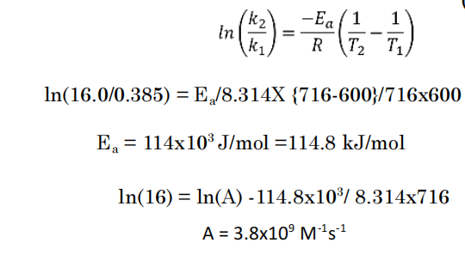
Example: If you know that the reaction of ammonia with carbon dioxide is in its initial stages of the second order and the value of the reaction rate constant at a temperature of 327 °C is equal to 0.385 mol ⁻¹. sec⁻¹ , and at a temperature of 443°C is equal to 16.0 mol ⁻¹. sec⁻¹, then calculate 1- Activation energy 2- Frequency coefficient (Arrienus constant):

